Slide 1
DATA SECURITY SYSTEMS PROJECT PRESENTATION ON DIGITAL WATERMARKING
By
ANURAG BEJ – 19162171004
AMAAN BOLWALA – 19162171005
RUDRa brahMBHATT - 191621710006
DHAIRYA CHANGELA – 19162171007

Slide 2
Table of Contents
Introduction
Objectives
Tools & Technology
Application
Flowchart
Implementation Details
Conclusion
Reference

Slide 3
INTRODUCTION
Digital Watermarking is the process of embedding information into digital multimedia content (i.e. image, audio, video, document etc.) such that the information can later be extracted for a variety of purposes including copy prevention and control.
Digital watermarking is divided into two types such as visible watermark and invisible watermark.
I. Visible Watermark: This watermarks are visible. It can be a logo or a text that denotes a digital medium's owner.
II. Invisible Watermark: These watermarks are embedded in the media and use steganography technique. They are not perceptible to a human observer.

Slide 4
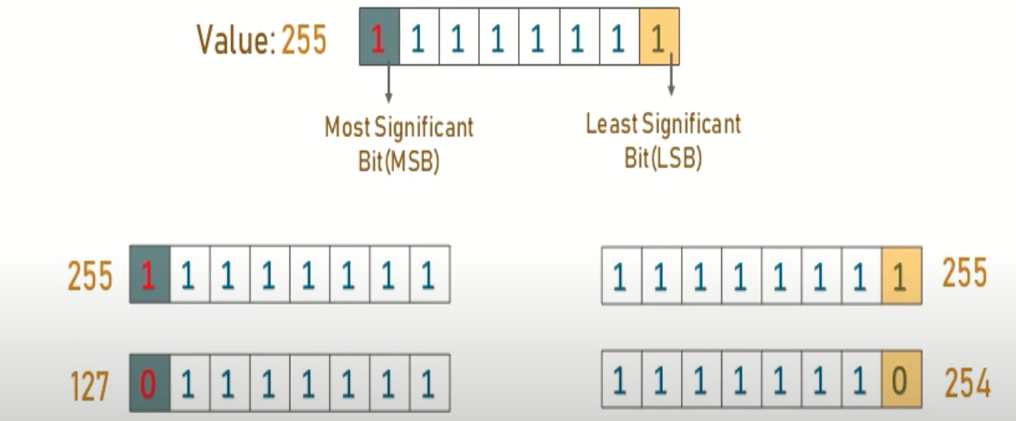
In order to perform Invisible watermarking we are using “Least Significant Bit Steganography” technique to hide text messages in image.
Least Significant Bit steganography is one such technique in which least significant bit of pixels of the image is replaced with data bits. This approach has the advantage that it is simplest one to understand, easy to implement and results in stego-images that contain embedded data as hidden.

Slide 5
OBJECTIVES
Let user select the image for message to hide in it.
Get message from user that he want to hide
Perform Steganography technique to encrypt/decrypt message

Slide 6
TOOLS & TECHNOLOGY
Any python IDE (i.e. VS Code)

Slide 7
APPLICATION
Watermarks are used in forensics. Tampered evidence is unacceptable in forensics and Watermarked images are acceptable.
This is used by brands. The Digital Watermarking is done so that the authority of the digital media is intact.
Digital Watermarking prevents copying of the data.
Video editing software use watermarks so that people buy the full version of it.
It is used in video authentication. News channels often show videos of other agencies which are watermarked. It is also used for ID card security.
It is used for content management in social media.

Slide 8
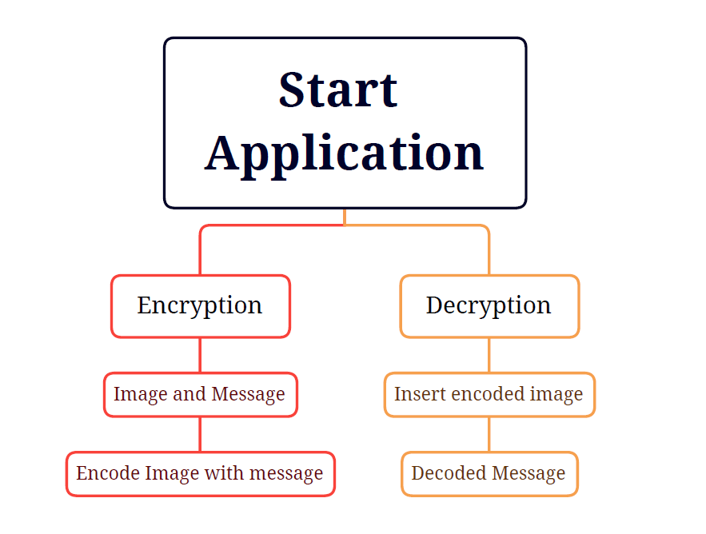
Flowchart

Slide 9
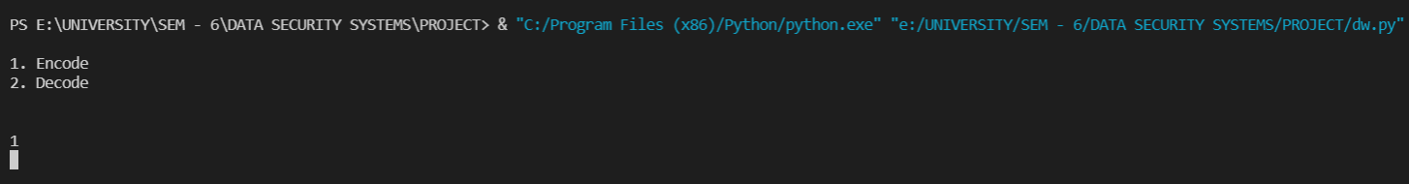
Implementation Details
Encode:
Run the python code and select encode as translation method.

Slide 10
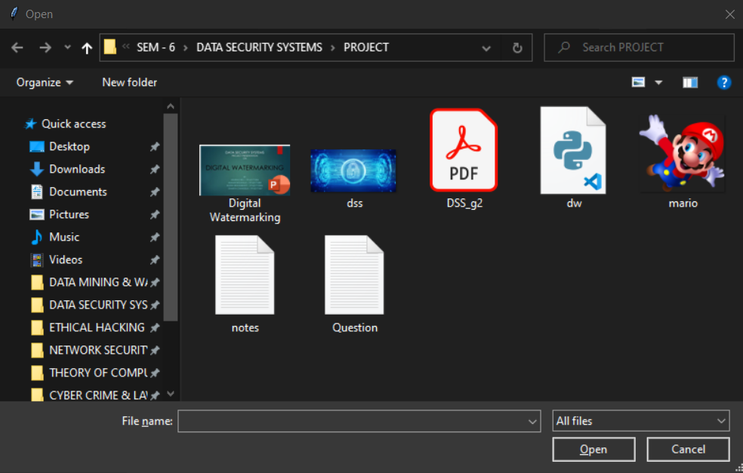
Browse the image you want to hide text in.

Slide 11
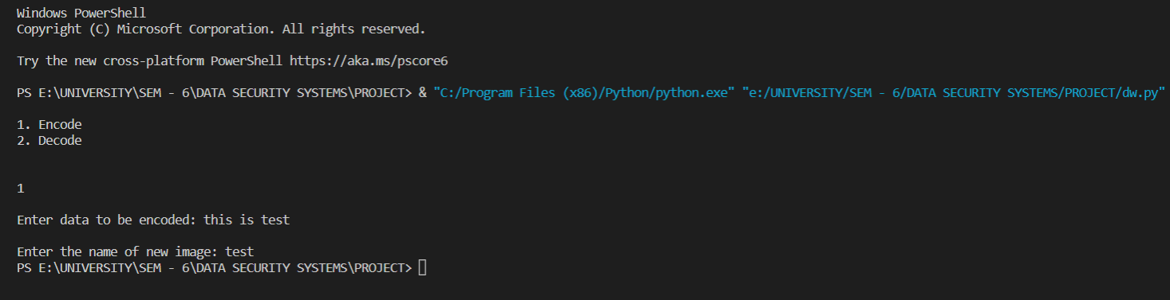
Now Enter the text message that you want to hide with the image and provide name you want give to the encoded image file.
The text message is successfully embedded in the image.

Slide 12
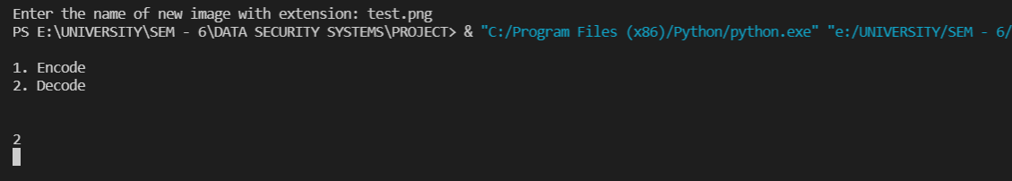
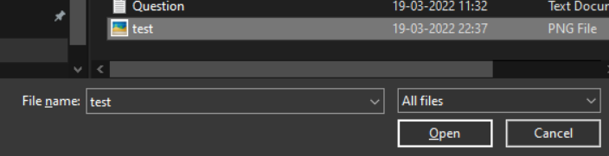
Decode:
Run the python code and select decode as translation method.
Select the encoded image.

Slide 13
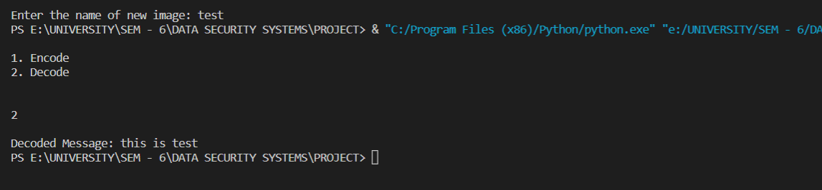
The image will be immediately decoded as soon as you select the image.
Thus the encrypted text will be shown in the terminal.

Slide 14


Final Image
Normal Image
Encoded Image

Slide 15
CONCLUSION
In this project we conclude that we can hide secret messages in image, video, audio etc. such a way that no one, apart from the sender and intended recipient, suspects the existence of the message.

Slide 16
REFERENCES
https://www.geeksforgeeks.org/digital-watermarking-and-its-types/
https://www.geeksforgeeks.org/image-based-steganography-using-python/

Slide 17
THANK YOU !

